Slide 1
Session – 10
Building Requirements Model

Slide 2
Recap for session 9
What is Requirements ?
Types of requirements
Functional requirements
Non-functional requirements
Domain requirements
Requirements engineering
Stages of requirement engineering

Slide 3
Agenda for session 10
Elements of the Requirements Model
Types of Elements of the requirements
Scenario-based elements
Class-based elements
Behavioral elements
Flow-oriented elements
Analysis Patterns
Negotiating Requirements
Validating Requirements
Software requirements specification (SRS)
SRS Vs User Stories

Slide 4
Elements of the Requirements Model
The specific elements of the requirements model are dictated by the analysis modeling method that is to be used. However, a set of generic elements is common to most requirements models.
Scenario-based elements
Class-based elements
Behavioral elements
Flow-oriented elements
Analysis Patterns

Slide 5
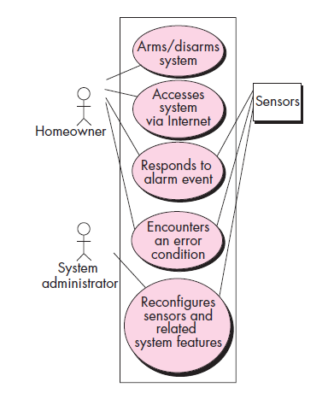
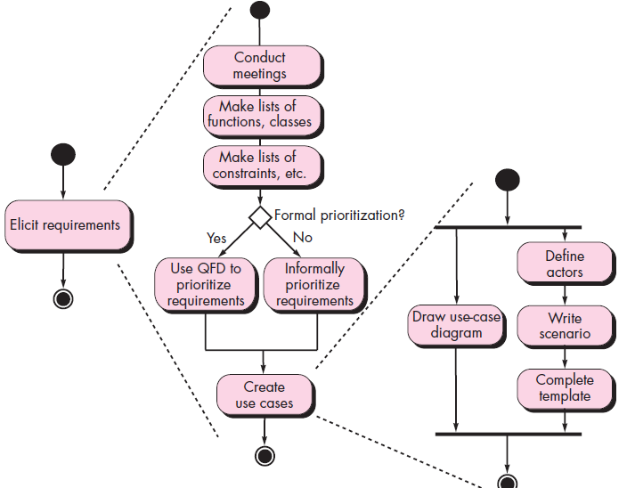
1.Scenario-based elements
Elements of the Requirements Model
Use Case Diagram for Safe home
Activity Diagram for safe home

Slide 6
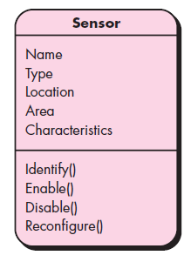
2. Class-based elements
Class Diagram for Sensor

Slide 7
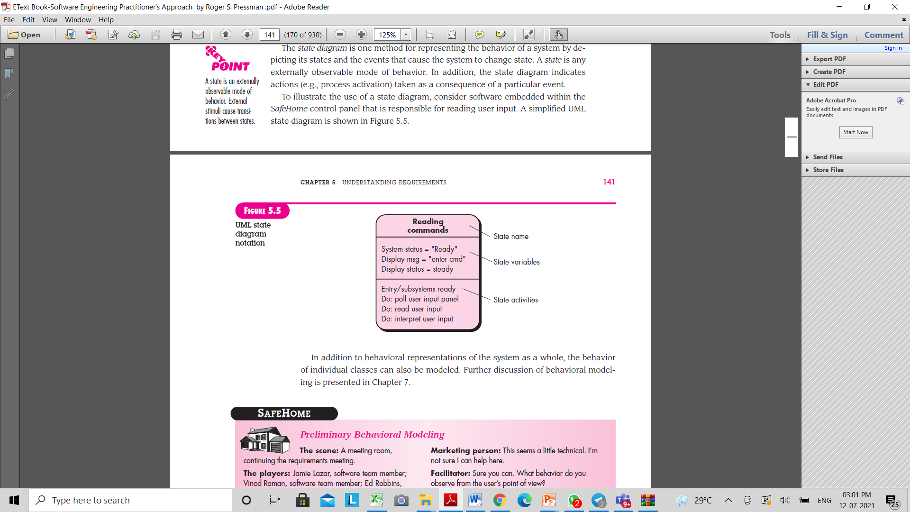
3.Behavioral Elements

Slide 8
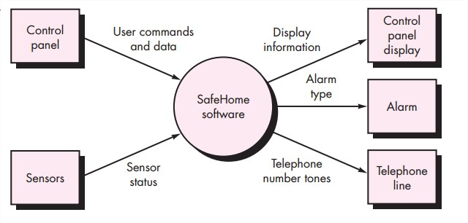
4. Flow-oriented elements:
  Information is transformed as it flows through a computer-based system.
  The system accepts input in a variety of forms; applies functions to transform it; and produces output in a variety of forms.

Slide 9
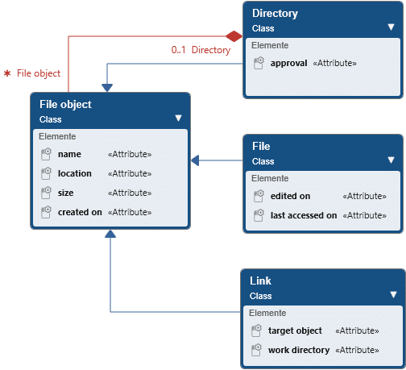
4.Analysis Patterns
Anyone who has done requirements engineering on a number of software projects will note that some issues repeat across all projects within a certain application area. These patterns of analysis provide solutions (e.g., a class, a function, or a behaviour) inside the application domain that can be reused when modelling several applications.
By referencing the pattern name, analysis patterns are integrated into the analysis model. They are also stored in a repository so that requirements engineers can find and apply them using search facilities. Information about an analysis pattern (and other sorts of patterns) is contained in a standard template.

Slide 10
Negotiating Requirements
The inception, elicitation, and elaboration tasks in an ideal requirements engineering setting determine customer requirements in sufficient depth to proceed to later software engineering activities.
Boehm [Boe98] defines a set of negotiation activities at the beginning of each software process iteration. Rather than a single customer communication activity, the following activities are defined:
1. Identification of the system or subsystem’s key stakeholders.
2. Determination of the stakeholders’ “win conditions.”
3. Negotiation of the stakeholders’ win conditions to reconcile them into a set of win-win conditions for all concerned (including the software team).

Slide 11
Validating Requirements
Verification
  designing the product right
Validation
  designing the right product
The formality gap
  validation will always rely to some extent on subjective means of proof
Management and contractual issues
  design in commercial and legal contexts
Real-world
requirements
and constraints
The formality gap

Slide 12
Validating Requirements
In the Validation process few questions should be asked and answered to ensure that the requirements model is an accurate reflection of stakeholder needs and that it provides a solid foundation for design.
Each aspect of the requirements model is checked for consistency, omissions, and ambiguity as it is developed. The model’s requirements are prioritised by stakeholders and bundled into requirements packages that will be implemented as software increments.

Slide 13
Software requirements specification
A software requirements specification (SRS) is a document that captures complete description about how the system is expected to perform. It is usually signed off at the end of requirements engineering phase.
Qualities of SRS:
Correct
Unambiguous
Complete
Consistent
Ranked for importance and/or stability
Verifiable
Modifiable
Traceable

Slide 14
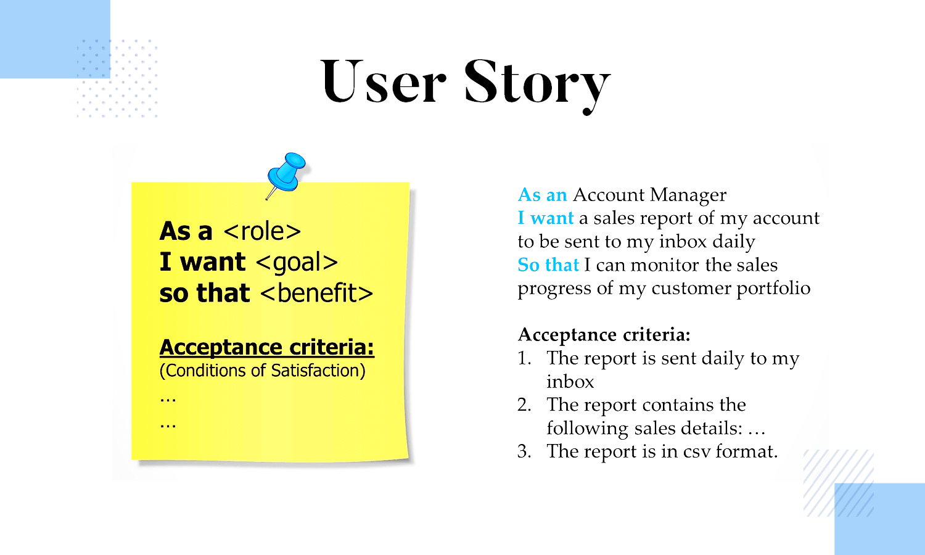
User Stories
A user story is an informal, general explanation of a software feature written from the perspective of the end user or customer. The purpose of a user story is to articulate how a piece of work will deliver a particular value back to the customer.

Slide 15
(Software requirements specification) SRS Vs User Stories
User Stories
Provide a small scale and easy to use presentation of information. Are generally formulated in the everyday language of the user and contain little detail, thus remaining open to interpretation. They should help the reader understand what the software should accomplish.
Must be accompanied by acceptance testing procedures for clarification of behavior where stories appear ambiguous.
SRS
Software requirements specification establishes the basis for an agreement between customers and contractors or suppliers on how the software product should function.

Slide 16
Questions
1.Develop a complete use case for one of the following activities:
  a. Making a withdrawal at an ATM
  b. Using your charge card for a meal at a restaurant
  c. Buying a stock using an on-line brokerage account
  d. Searching for books (on a specific topic) using an on-line bookstore.
Develop a checklist for conducting a requirements gathering meeting.
3. Why do we say that the requirements model represents a snapshot of a system in time?
4. Why is it that many software developers don’t pay enough attention to requirements engineering? Are there ever circumstances where you can skip it?
5. Discuss some of the problems that occur when requirements must be elicited from three or four different customers.
6. Define the metrics for specifying the NON-functional Requirements.
7. Discuss in detail the user Requirements?
8. Elaborate on software requirements document in detail?

